Slide 1
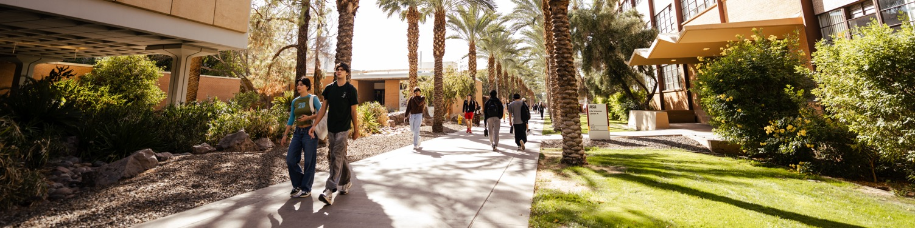

2026 Official ASU presentation template
Prepared by ASU Enterprise Brand Strategy and Management for enterprise-wide distribution and use

Slide 2
What’s new in the 2026 template
Streamlined flexibility.
New and revised slide options added directly to this template’s theme
Streamlined layout options with flexible titles, subtitles and preheaders
Slide layouts now organized by most common use to help you find what you need faster.
More photo-based layouts available in the ⇨ ASU presentation toolkit
New tools, photo and graphic options added to the presentation tool kit
The 2026 ASU presentation template has been streamlined to make it easier to build clear, on-brand slides for presentations and report-style decks — while giving you more flexibility when you need it.

Slide 3
How to use this template
Getting started

Slide 4
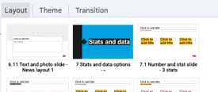
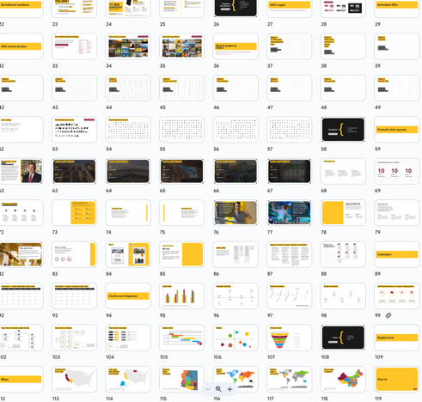
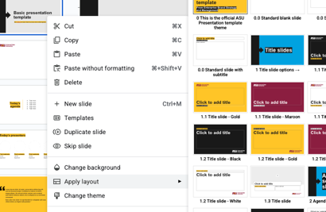
More layouts, more tools, more graphics
Two options to support your presentations and decks:
1
2
In your copy of the template:
Find more layouts in the
Layout menu above ⇧
In the ASU presentation toolkit:
Find additional slide layouts, graphics and tools — including more visual, photo-based and custom layouts that aren’t part of the core template.
Toolkit quick links
University messaging
Graphics and photos
Templates
Tools
How to:
Add your own images
Embed video into your presentation
Turn on slide layout guides
Brand standards and guidelines
Color palette
ASU Brand standards
⇦ You can also right-click any slide in the preview panel to apply a different layout.

Slide 5

Green = Content safe zone
Red = Reserved for accessibility overlays
Revised for 2026:
This only applies to slides that will be presented live (in person or online) or recorded and shared
To ensure Closed Captions and live transcription overlays do not obscure meaningful content, use this guide to inform where you place critical text on your slides.
For slides intended for independent up close reading review only: Text can safely extend beyond this area of the slide.
Throughout the template, you’ll see this area indicated to the left of slides for reference.
If using layout guides, the reserved area is indicated with a dotted red line for your reference.
To turn layout guides on/off: View > Guides > Show/Hide Guides
The university is federally required, per Civil Rights Laws (ADA Title II compliance), to meet WCAG AA accessibility requirements in digital environments:
https://www.w3.org/WAI/WCAG21/
Understanding/captions-live.html
Avoid placing important text in this area of the slide to accommodate live transcription and Closed Captions overlay.

Slide 6
Basic presentation template
Getting started
See slide 7 to learn how to access more slide layouts, tools and graphics.
Find additional ASU templates for spreadsheets, documents and more
on the Enterprise Brand, Communications and Marketing Guide

Slide 7
Presentation or report
title goes here
Optional subtitle or brief description
Presenter name(s), date or event title

Slide 8
Name
Today’s presenter
Title, organization, brief bio.
Add a photo of the presenter.
Include this slide when introducing speakers or presenting externally.

Slide 9
Today’s agenda
Topic or discussion point
Topic or discussion point
Topic or discussion point
Topic or discussion point

Slide 10
Section title goes here
Optional one-line framing or context

Slide 11
Slide title
Key point
Supporting detail
Supporting detail

Slide 12
Slide title
Slide subtitle
Use this two-column slide for key points, explanations or discussion notes.
Keep text concise and focused.

Slide 13

Slide title
Add brief supporting text or key points here and add image to help illustrate the message.

Slide 14
Subsection title goes here
Add a preheader or title of the section this is part of

Slide 15
Highlight key numbers
10
10
10
What this number represents
What this number represents
What this number represents
Brief explanation or source, if needed
Brief explanation or source, if needed
Brief explanation or source, if needed

Slide 16
Insert quote or highlighted statement here.
— Name, title or source

Slide 17

Thank you
Questions or discussion
Contact information

Slide 18

Closing slide

